Slide 1
PowerPoint Series on Geography of China (2) – Relief of our country
Personal, Social and Humanities
Education Section, Curriculum
Development Institute,
Education Bureau
Student Self-study Version

Slide 2
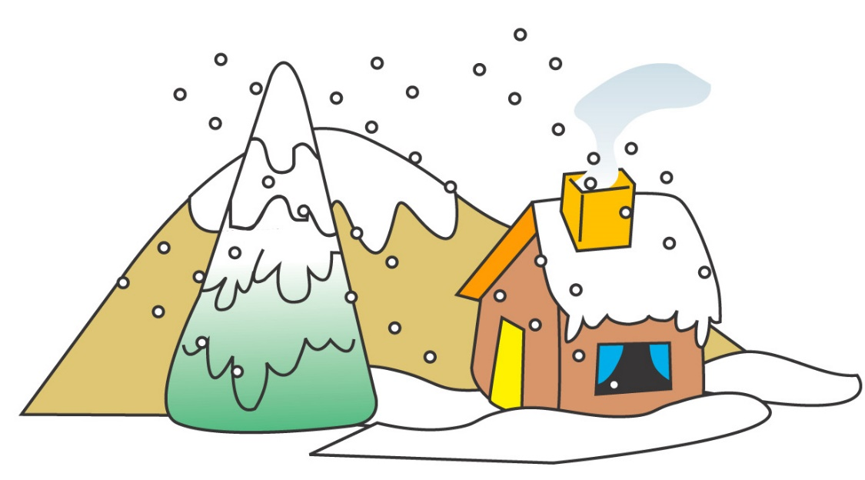
The Topographical Setting of our country – The three-tier (three-step) pattern
Our country has a large land mass and a wide variety of landforms – mountain ranges, plateaus, basins, hilly areas and plains
The topography of our country is high in the west and low in the east, showing a general trend of three steps down (Figure 1). This is the so-called "three-tier (three-step) pattern of relief“.

Slide 3
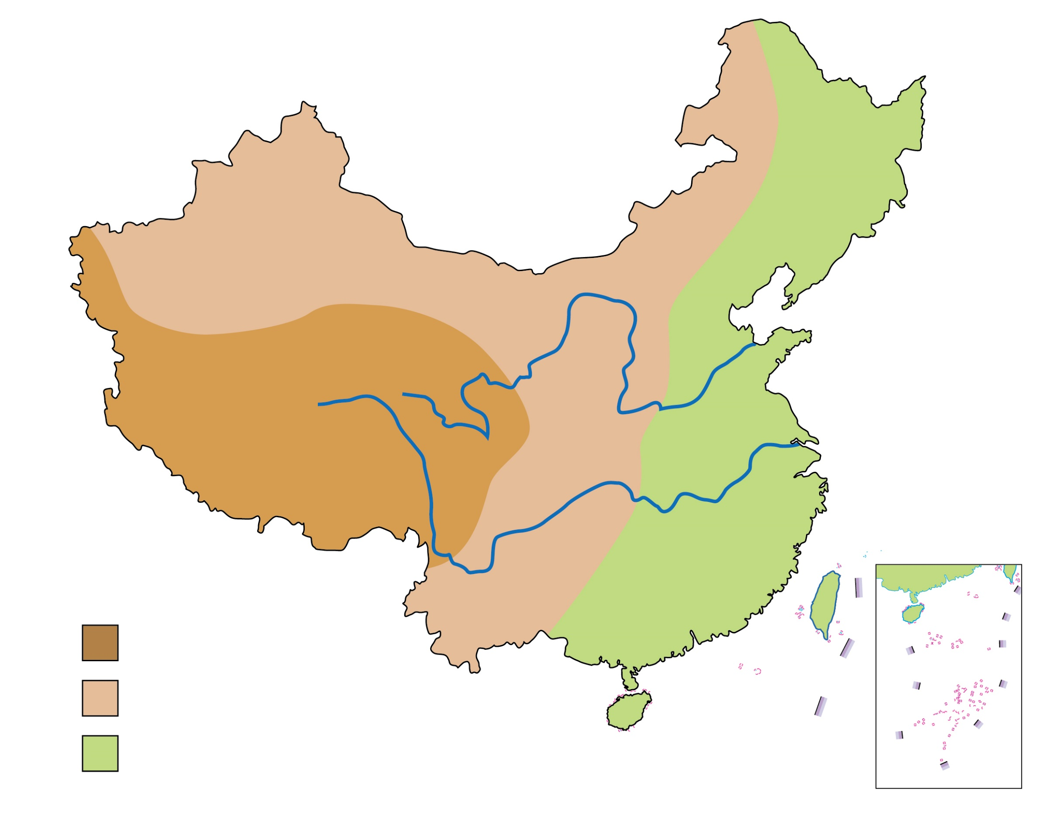
Figure 1 A map showing the three-tier pattern of relief & major rivers of our country (& related information)
River | Length of the river (Source of data：《China Statistical Yearbook 2021》) | Annual runoff (Source of data：《China Statistical Yearbook 2021》)
Huang He | 5,464 km | 59.2 billion cubic meters
Chang Jiang | 6,300 km | 985.7 billion cubic meters
Huang He
Chang Jiang
Key
1st tier/step
2nd tier/step
3rd tier/step

Slide 4
As seen from Figure 1 above, the three-tier pattern of relief of our country is high in the west and low in the east. The characteristics and examples of the tiers are as follows:
Three-tier pattern of relief | Characteristics & Examples
1st tier/step | The 1st tier includes high mountains such as the Tibetan Plateau with an average altitude of over 4,000m in southwestern part of our country.

Slide 5
Three-tier pattern of relief | Characteristics & Examples
2nd tier/step | The height of the 2nd tier is about 1,000-2,000m above sea level, and some areas can be below 500m. This region spanning the central, northern and northwestern parts of our country has a series of highland above 1,500m above sea level, such as Altai Shan, Tianshan, Inner Mongolia Plateau, Loess Plateau, Yungui Plateau, Zunggar Basin, Tarim Basin, Qaidam Basin and Sichuan Basin.

Slide 6
Three-tier pattern of relief | Characteristics & Examples
3rd tier/step | Crossing Daxinganling (Greater Khingan Range) to Xuefeng Shan, all the way to the eastern coast, it is the 3rd tier of our country’s topography. There are plains and hills below 500m in altitude. Examples of the 3rd tier include the Northeast China Plain, North China Plain, the middle and lower courses of Chang Jiang Plain, and the southeast hills (southeast hilly areas), etc.

Slide 7
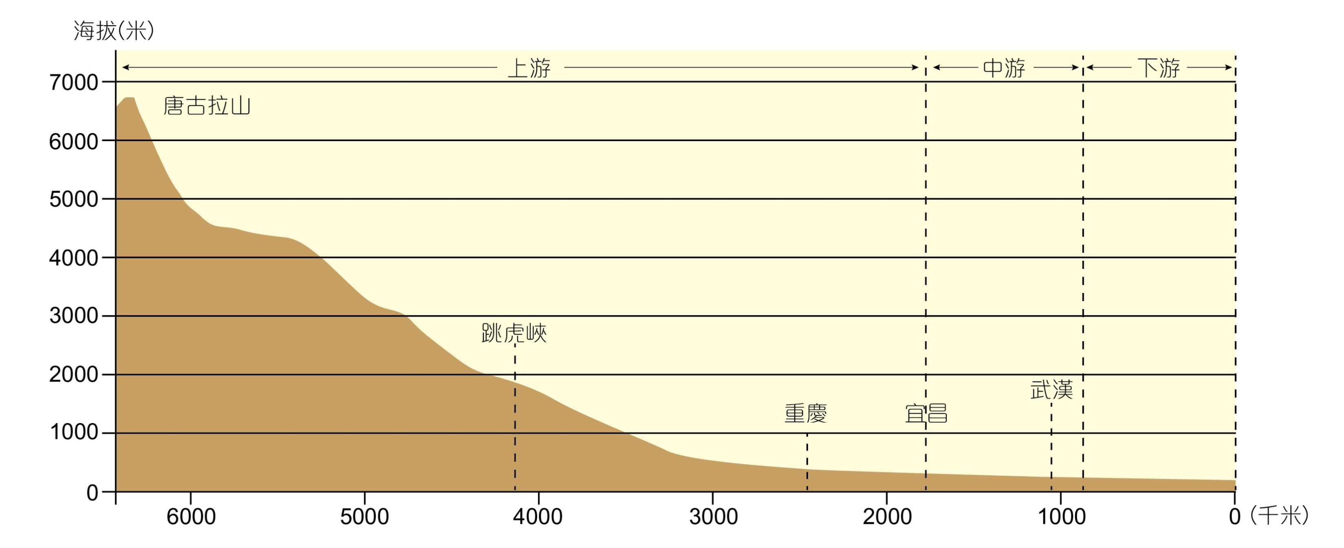
Taking Chang Jiang in Figure 1 as an example to draw a profile, we can see that the flow direction of the major rivers (such as Chang Jiang and Huang He) also roughly reflects the topography of our country's high west and low east (see Figure 2 below)
Figure 2 A profile of Chang Jiang
Altitude (m)
Middle course
Lower course
Upper course
Tanggula Mountains
Tiger Leaping Gorge
Chongqing
Yichang
Wuhan
West
East
West
(km)

Slide 8
Characteristics of our country’s topography-more mountains and less flat lands
Mountainous topography is a major relief characteristic of our country. In terms of height, the lowlands below 500m only account for 25% of the country’s total land area, while the highlands above 500m account for about three-quarters.
Uplands (including mountain ranges, plateaus and hills) account for about 69% of the total land area.
On the contrary, flat lands / lowlands (including basins and plains with flat terrain) only accounts for about 31% of the total area.

Slide 9
Mountain Ranges
A “mountain range” refers to a series of connected mountains. Mountain ranges form the topographic framework of our country.
Although mountain ranges seem to be intertwined with each other, certain patterns can be identified. It can be roughly divided into four groups of mountain ranges in Figure 3:
East-West Mountain Ranges
Northeast-Southwest Mountain Ranges
North-South Mountain Ranges
Northwest-Southeast Mountain Ranges

Slide 10
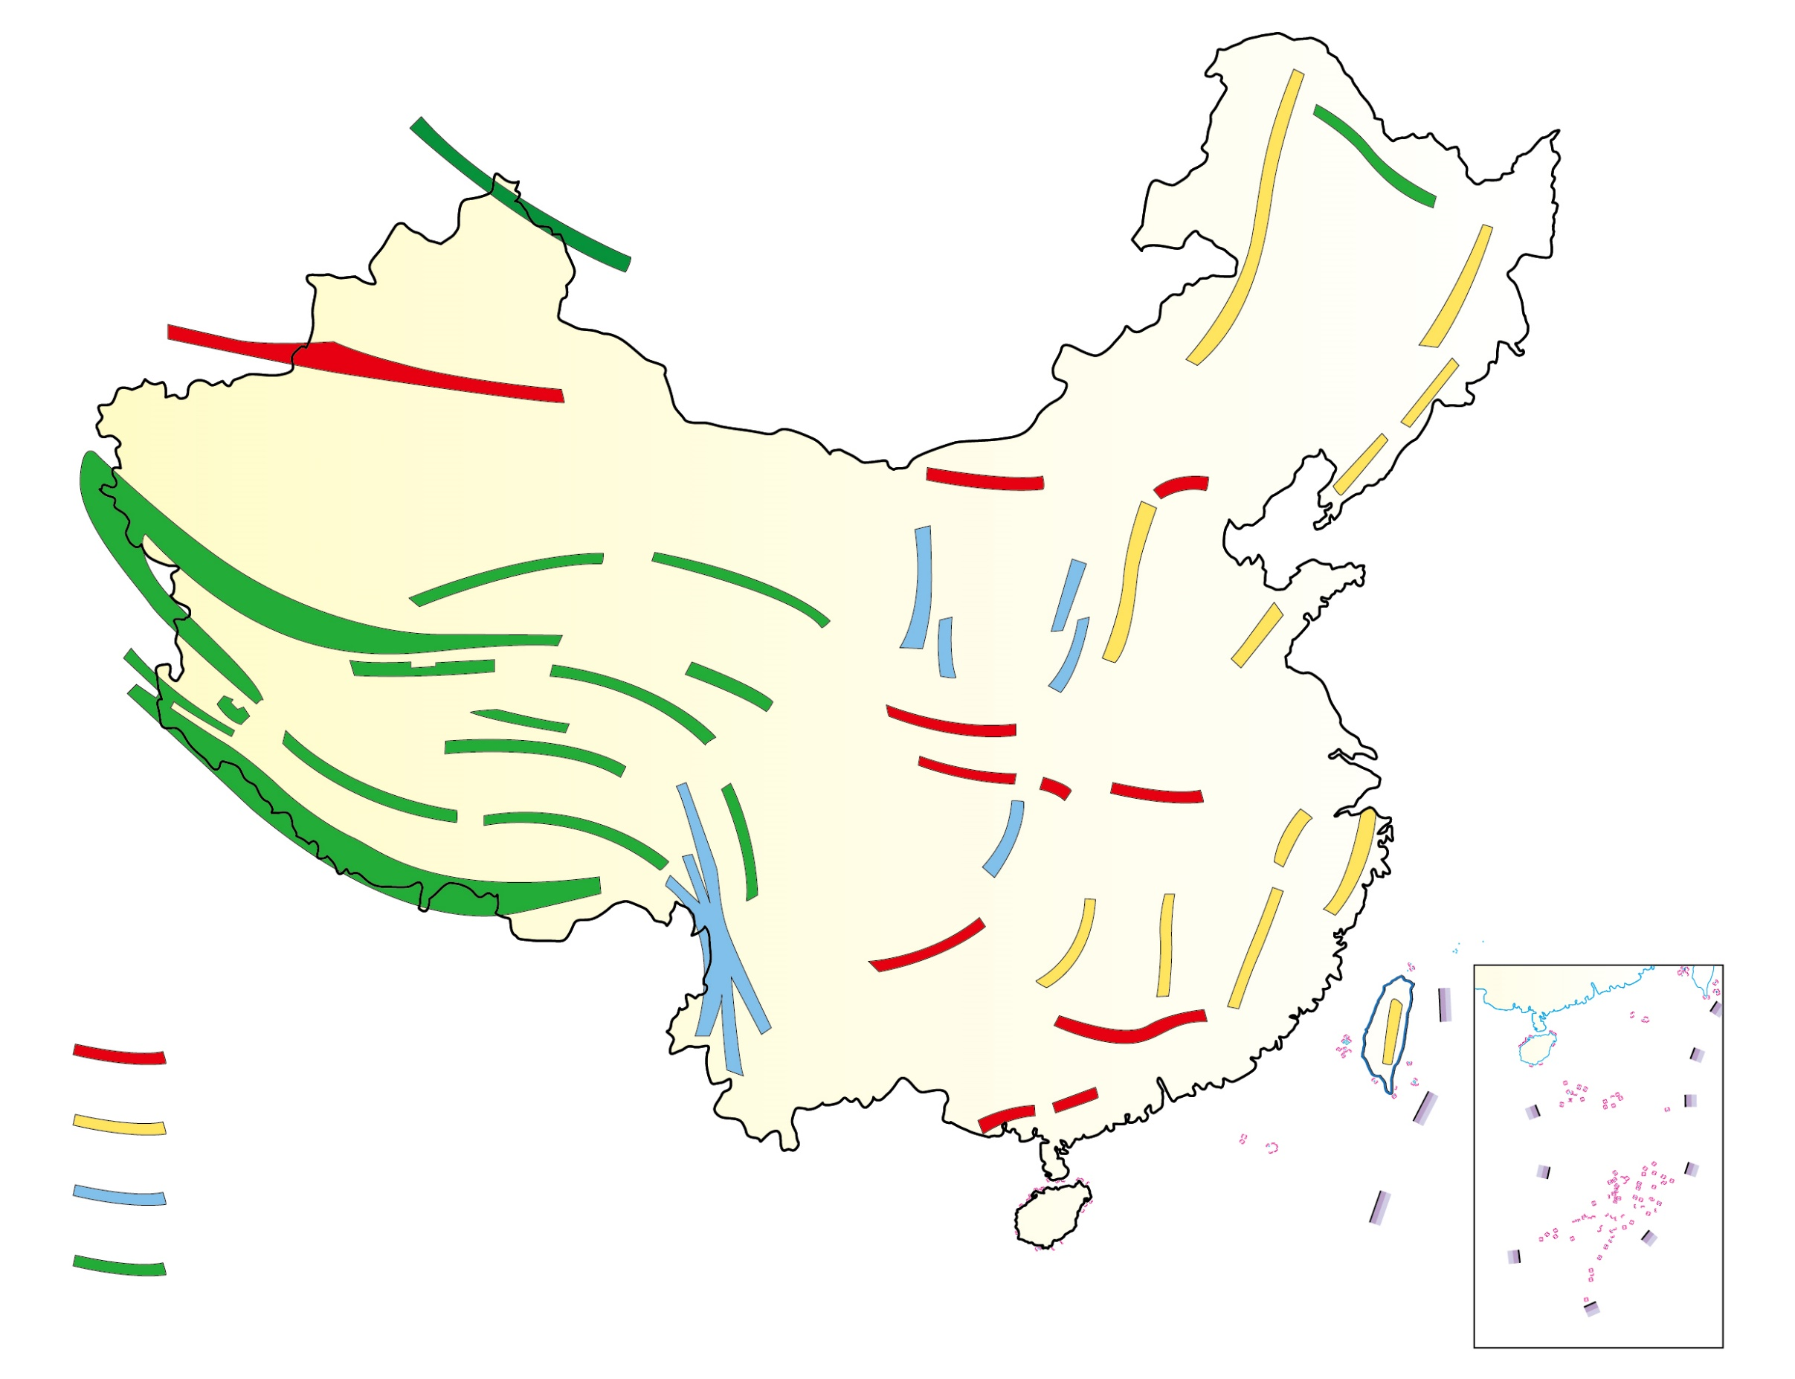
Altay Mountains
Tianshan Mountains
Yanshan
Mountains
Yinshan
Mountains
Kunlun Mountains
Qilian Mountains
Taihang
Mountains
Tanglha Mountains
Wuyi
Mountains
Himalayas
Hengduan
Mountains
Key
East-West Mountain Range
Northeast-Southwest Mountain Range
North-South Mountain Range
Northwest-Southeast Mountain Range
Figure 3 The 4 major groups of mountain ranges in our country (Source: P.70 of the book “Learning the Geography of China through Reading (Part 1): The physical environment” published by the Education Bureau (Hong Kong) in 2013.)

Slide 11
Mountain Ranges | Distribution & Examples
East-West Mountain Ranges | Including the northern range of Tianshan – Yinshan, the middle range of Kunlun Mountain – Qinling, and the southern range of Nanling
2) Northeast-Southwest Mountain Ranges | Mainly located at East China and can be divided into 3 mountain ranges: The western mountain range comprises Daxinganling, Taihang Shan, Wushan and Xuefeng Shan; the middle range comprises Changbai Shan and Wuyi Shan; and the east range is the mountain ranges in Taiwan.

Slide 12
Mountain Ranges | Distribution & Examples
3) North-South Mountain Ranges | There are two mountain ranges in this group: 1) Helan Shan and Liupan Shan in the central part; and 2) Hengduan Shan in the southwestern part.
4) Northwest-Southeast Mountain Ranges | Also known as the Qinghai-Tibet Plateau, including the Altay Mountains, Qilian Mountains and the Himalayas

Slide 13
Plateaux
There are four major plateaux: Qinghai-Tibet Plateau, Inner Mongolian Plateau, Loess Plateau and Yunnan-Guizhou Plateau (Figure 4).
Except that the Qinghai-Tibet Plateau is located on the 1st tier of the relief, the other three plateaus are located on the 2nd tier.
1) Qinghai-Tibet Plateau: It is located in the southwestern part and mainly includes Xizang, Qinghai and western Sichuan. It is the largest and highest plateau in our country, with an average elevation over 4,000m.

Slide 14
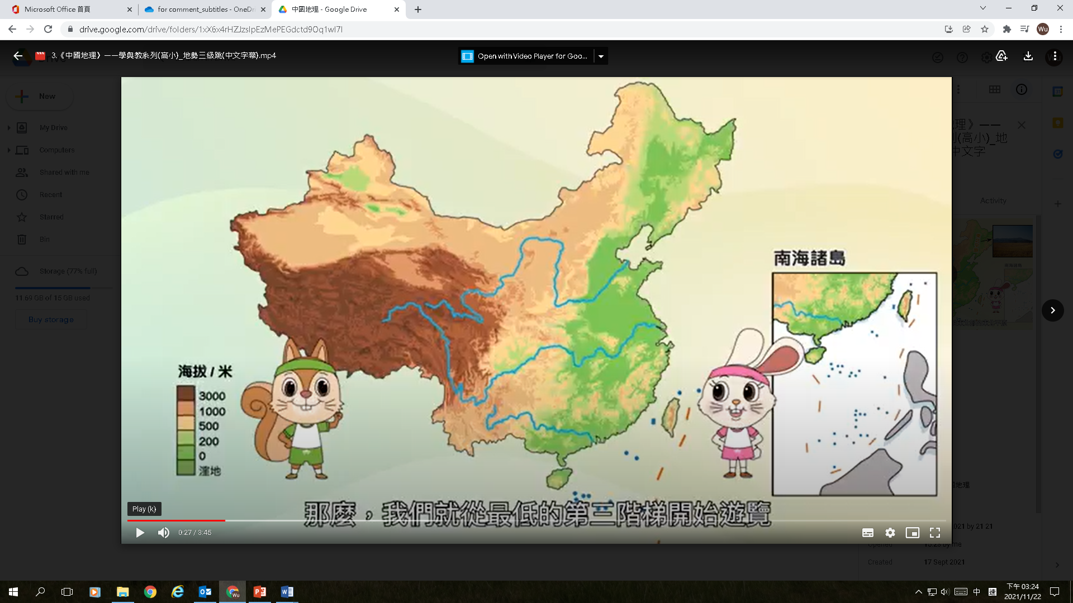
Inner Mongolian
Plateau
Archipelagos in the South China Sea
Loess
Plateau
Qinghai-Tibet Plateau
Altitude/m
Yunan-Guizhou
Plateau
Swampy area
Figure 4 The four major plateaux in our country

Slide 15
2) Inner Mongolian Plateau: It is located in the northern part and mainly includes most parts of Nei Mongol and parts of Gansu, Ningxia and Hebei.
3) Loess Plateau: The Loess Plateau is the thickest and largest loess in the world. Its location is just south of the Inner Mongolia Plateau, including Shanxi, and parts of Shaanxi, Gansu, and Ningxia.
4) Yunnan-Guizhou Plateau: It is located in the southwestern part and occupies much of Yunnan and Guizhou.

Slide 16
Basins
There are 4 major basins in our country. They are Tarim Basin, Junggar Basin, Qaidam Basin, and Sichuan Basin (Figure 5), and all of them are located on the 2nd tier of the relief of our country.
1) Tarim Basin: The Tarim Basin is located in southern Xinjiang and is the largest basin in our country, with an elevation of about 800-1,300m. The terrain of the Tarim Basin is high in the west and low in the east. Its center is the largest desert in our country - the Taklamakan Desert, and its edge is an oasis belt.

Slide 17
Junggar
Basin
Tarim Basin
Archipelagos in the South China Sea
Qaidam
Basin
Sichuan
Basin
Altitude/m
Swampy area
Figure 5 The four major basins in our country

Slide 18
2) Junggar Basin is located in northern Xinjiang at an altitude of about 500-1,000m. It is the second largest basin in our country. Its terrain is also high in the west and low in the east. Its central part is the second largest desert in our country - Gurbantunggut Desert.
3) Qaidam Basin is located in the northwest of Qinghai Province. It is the highest basin in our country, with an elevation of about 2,500-3,000m. There are many salt lakes and swamps in its southeast.

Slide 19
4) Sichuan Basin is located in the east of Sichuan Province at an altitude of about 250-700m. Its terrain is high in the northwest and low in the southeast, with plains, hills, low mountains and rivers. Because of the warm climate and fertile land, the Basin is rich in natural resources and has the reputation of "the kingdom of heaven“.

Slide 20
Plains
There are three major plains in our country, from north to south, followed by the Northeast Plain, North China Plain, and the middle and lower Yangtze Valley Plain, all distributed on the 3rd tier with the lowest topography in the eastern part (Figure 6).
1) Northeast Plain: It is located in the northeastern part, surrounded by Daxinganling, Xiaoxinganling and Changbai Shan. It includes parts of Heilongjiang, Jilin, Liaoning and Nei Mongol, and is the largest plain in our country.

Slide 21
Its area is about 350,000 km², and its altitude is mostly below 200m. Except for the slightly higher terrain in the middle, the terrain of most places is gentle. Widespread fertile black soils and fresh water marshes are prominent features of the Plain.
2) North China Plain: It is located at the northern part of East China and is demarcated by Yan Shan, Taihang Shan and Huaihe. It occupies parts of Hebei, Henan, Shandong, Beijing, Tianjin, Jiangsu and Anhui.

Slide 22
Northeast
Plain
Archipelagos in the South China Sea
North
China
Plain
Middle and Lower Yangtze Valley Plain
Altitude/m
Swampy area
Figure 6 The three major plains in our country

Slide 23
The North China Plain is the second largest plain in our country. It is formed by alluvial deposits from the Huang He, Huaihe and Haihe, and has an area of 310,000km². The land there is flat and is less than 50m above sea level in most cases.
3) The middle and lower Yangtze Valley Plain: It includes many plains from the east of Wushan to the mouth of Chang Jiang, such as Dongting Lake Plain, Jiang Han Plain, Boyang Lake Plain, Jiangsu-Anhui River Plain and Chang Jiang Delta. With a total area of about 200,000 km², it is the third largest plain in our country.

Slide 24
Hills
Our country's hilly land is mainly distributed in the eastern coastal areas. The three major hilly areas (Figure 7) include：
Southeast Hills：It is the largest hilly area in our country, including a large area of land east of Xuefeng Shan and a large area of land south of Chang Jiang
Liaodong Hills
Shandong Hills

Slide 25
Liaodong Hills
Archipelagos in the South China Sea
Shandong Hills
Altitude/m
Southeast Hills
Swampy area
Figure 7 The three major clusters of hills in our country

